Slide 1
Presentation during the visit of WHO Epidemiologist encharged for LEPROSY in the world (global lidership)
Hansen´s Disease Seminar in Brasil, Brasília and Research Reference Centers – ILSL, BAURU 03-02-23

Slide 2
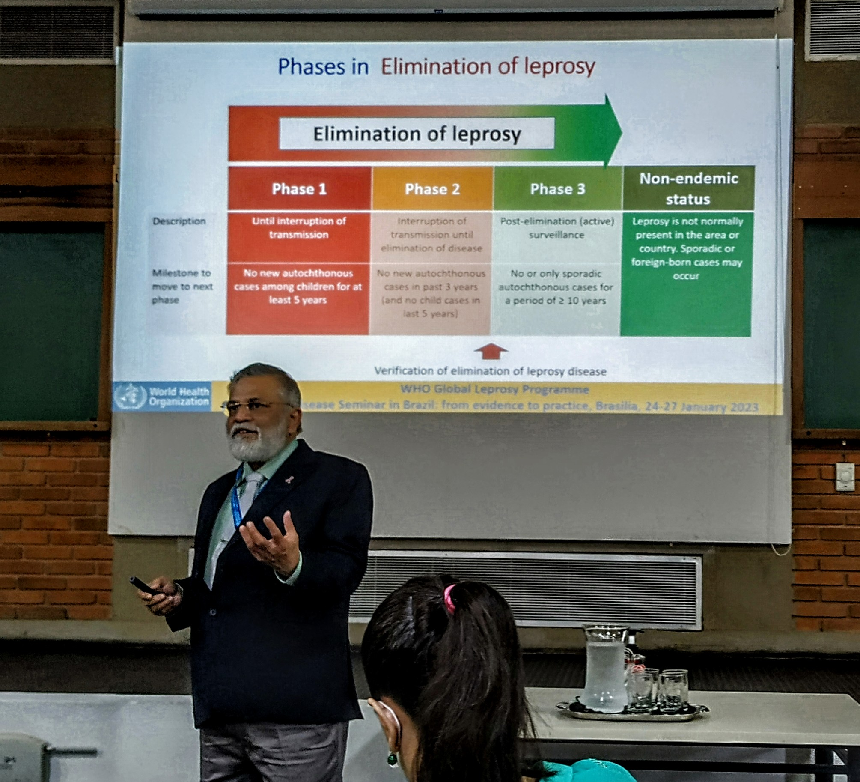
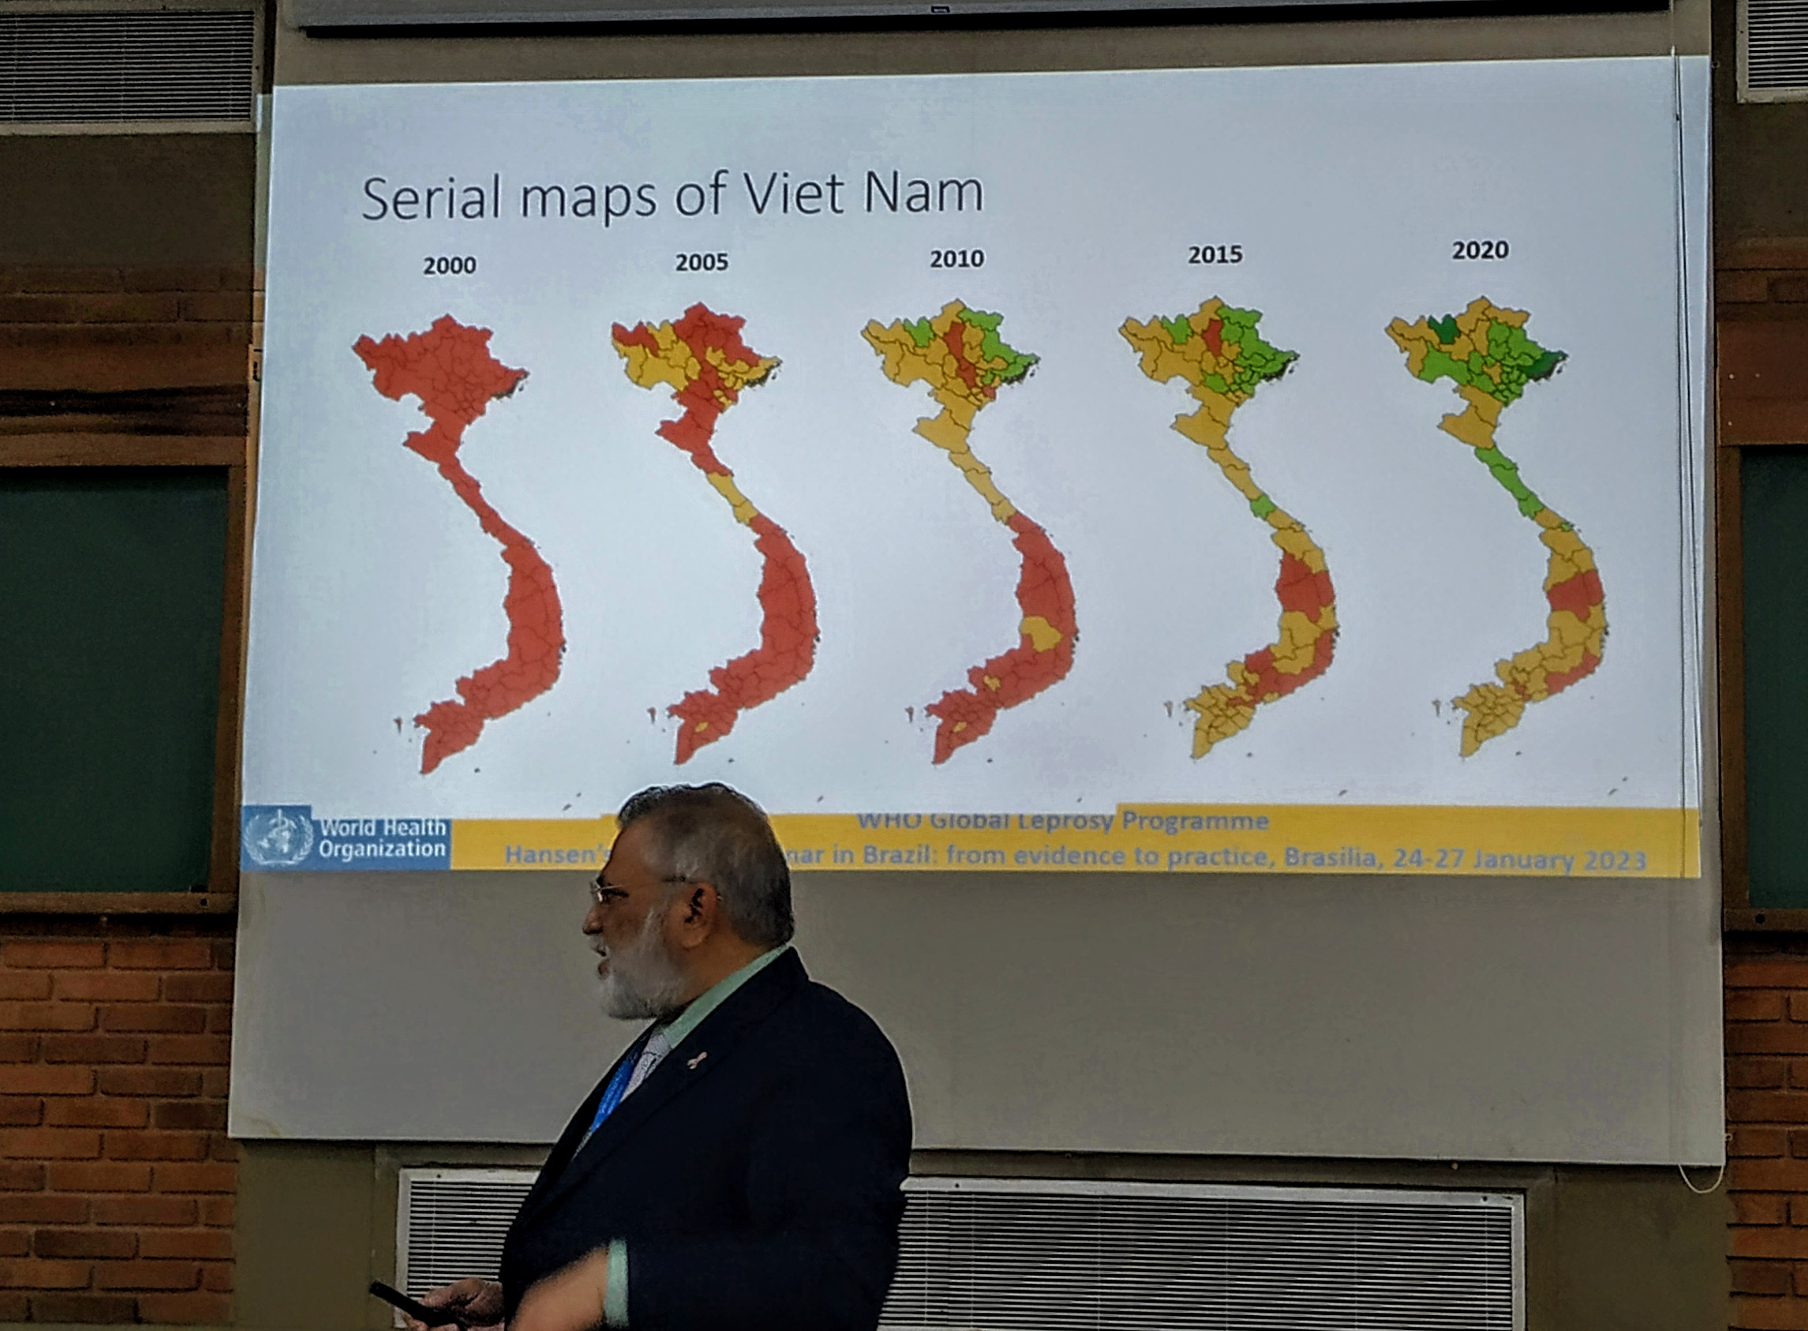
WHO (OMS) GLOBAL LEPROSY PROGRAMME FOR ENDEMIC AND NON ENDEMIC COUNTRIES – Dr. Venkata Ranganadha Rao Pemmaraju, India
Epidemiological surveylance of each County of a State in one Country

Slide 3
Applied Research lines and Teaching Rehabilitation Branch and Clinical Neurophysiology
garbino
Instituto Lauro de Souza Lima, Bauru, 3rd February 2023

Slide 4
NERVE ASSESSMENT
GARBINO JA, HEISE CO, MARQUES WJr. Assessing nerves in leprosy. Clinics in Dermatology, v. 34, 2016
BORELA MCM, CURRY FILHO M, KIRCHNER DR, SALGADO MH, VIRMOND MCL, GARBINO JA. Neurophysiological comparative response to clinical and surgical treatment of the ulnar neuropathy in leprosy. Acta Fisiátrica, v. 27, 2020
ROBINS, GGR, ALEXANDRE PL, KIRCHNER DR, GARBINO JA. Nerve conduction studies of the tibial nerve across the tarsal tunnel in leprosy patients. Hansenologia Internationalis: Hanseníase e outras doenças infecciosas, v. 40, p. 3-8, 2015.
SOUZA A, NERY CAS, MARCIANO LHSC, GARBINO JA. Avaliação da neuropatia diabética: correlação entre sensibilidade cutânea dos pés, achados clínicos e eletroneuromiográficos. Acta Fisiátrica, São Paullo - Brasil, v. 12, n.3, 2005.
ARRUDA APM, , MARQUES WJr , FOSS NT, GARBINO JA, VIRMOND M, BARREIRA AA. Near nerve potential of sural nerve in leprosy. Arquivos de Neuro-Psiquiatria , São Paulo, Brasil, v. 62, 2004
MARCIANO LHSC, LEITE VM, ARAUJO PMP, GARBINO JA. Avaliação do comprometimento neurológico e da prevalência da síndrome do túnel do carpo em pacientes portadores de diabetes mellitus tipo 2. Acta Fisiátrica, 2007.
MARCIANO LHSC, GARBINO JA. Comparação de Técnicas de Monitoração da Neuropatia Hanseniana: Teste de Sensibilidade e Estudo de Condução Nervosa. Hansenologia Internationalis, Bauru/SP, v. 19, 1994
.

Slide 5
SOFTWARE FOR ASSESSING NERVES NervScore: only clinical Data (S-W, VMT and VAS)
Garbino JA, Bento LFM, Marques T, Quaggio CMP, Nardi SMT, Nicholl ARJ, Bentim C, Virmond M
INSTITUTO LAURO DE SOUZA LIMA & SORRI BAURU

Slide 6
SOFTWARE FOR ASSESSING NERVES -NervScore
Normal response ↓
No response, despite sufficient immunossuppressant doses 1mg/Kg= entrapment ?
INSTITUTO LAURO DE SOUZA LIMA & SORRI BAURU

Slide 7
Primary Neural Leprosy and Diferential Diagnosis
GARBINO JA. Commentary: -Primary Neural Leprosy mimicking rheumatological disorders-. Revista da Associacao Medica Brasileira , v. 65, p. 771-771, 2019
GARBINO JA, MARQUES Jr W, BARRETO JA, HEISE CO, JARDIM MMR, ANTUNES SL, SOARES CT, FLOARIANO MC, NERY JÁ, TRINDADE MAB, CARVALHO NB, ANDRADA NC, VIRMOND M, BARREIRA AA. Primary neural leprosy: systematic review. Arquivos de Neuro-Psiquiatria, v. 71, 2013
GARBINO JA. O paciente com suspeita de hanseníase primariamente neural. Hansenologia Internationalis, v. 32, 2007
162 pacientes foram submetidos à biópsia de nervos entre 1985 – 2005.
GARBINO JA, URA S, BELONE AFF, MARCIANO LHSC, FLEURY RN. Clinical and diagnostic aspects of the primarily neural leprosy. Hansenologia Internationalis, v. 29, 2004.
.

Slide 8
Pacients under nerve biopsy (1985-2005)
n =162
49 other etiology
Suspects
n =113
34 with HNP
1,7 cases/year
79 without diagnosis in the biopsy
Garbino, JA. O paciente com suspeita de hanseníase primariamente neural. Hansen Int, v. 32, 2007

Slide 9
Leprosy reactions
AKITA J, MILLER LHG, MELLO FMC, BARRETO J A, MOREIRA AL, SALGADO MH, KIRCHNER DR, GARBINO JA. Comparison between nerve conduction study and high-resolution ultrasonography with color doppler in type 1 and type 2 leprosy reactions. Clinical Neurophysiology Practice, 2022
GARBINO JA. Tratamento clínico da reações da hanseníase com repercussão neurológica: Revisão Histórica. Hansenologia Internationalis: Hanseníase e outras doenças infecciosas, v. 37, 2012
ROBLES MM, BALDISSEROTTO CM, GARBINO JA. Neuropatia da hanseníase versus CIDP. Hansenologia Internationalis: Hanseníase e outras doenças infecciosas, v. 37, p. 97, 2012
GARBINO JA, NAAFS B, SALGADO MH, URA S, VIRMOND M. Neurophysiological patterns of ulnar nerve neuropathy in leprosy reactions. Leprosy Review , 2010.
GARBINO JA, VIRMOND M, URA S, SALGADO MH, NAAFS, B. A randomized clinical trial of oral steroids for ulnar neuropathy in type 1 and type 2 leprosy reactions. Arquivos de Neuro-Psiquiatria, v. 66, 2008

Slide 10
EXPERIMENTAL CLINICAL NEUROPHYSIOLOGY-1
STIPP EJ, VITERBO F, LABBÉ D, GARBINO JA, BERNARDINELLI MM. Double muscle innervation using end-to-side. Revista Paulista de Medicina (Cessou em 1993. Cont. ISSN 1516-3180 São Paulo Medical Journal (Impresso), v. 130, 2012
STIPP EJ, ROMÃO AM, GARBINO JA, SALGADO MH, VITERBO F. Efeito da exposição de nervos e músculos no teste neurofisiológico em ratos. Acta Fisiatrica (USP), 2010
ROMÃO AM, VITERBO F, STIPP EJ, GARBINO JA, RODRIGUES JA. Eletroestimulação do músculo tibial cranial após esmagamento do nervo fibular comum: estudo neurofisiológico e morfométrico no rato. Revista Brasileira de Ortopedia, v. 42, 2007
GARBINO JA, VIRMOND M, ALMEIDA JA . Nerve Conduction Study Technique in the Armadillo. Hansenologia Internationalis, v. 21, 1996

Slide 11
EXPERIMENTAL CLINICAL NEUROPHYSIOLOGY-2
Almeida JA. Doutorado em Ciências Biológicas Anatomia. Estudo anatômico e eletrofisiológico do nervo Fibular Acessório. UNESP- Botucatu/SP, Orientador Mathias Vitti, UNICAMP, 2001.
Almeida JA. Mestrado em Ciências Biológicas Anatomia. Contribuição ao estudo da anatomia e eletrofisiologia dos nervos mediano e ulnar no antebraço (Anastomose de Martin-Gruber) UNESP- Botucatu/SP, Orientador Mathias Vitti, UNICAMP, 1996.
Almeida JA, Vitti M, Garbino JA. Estudo Anatômico da Anastomose de Martin-gruber. Hansenologia Internationalis, v. 24, 1999
Garbino JA , Almeida JA, Vitti M. Common anatomical nerve variations and nerve conduction studies: Martin–Gruber and Fibular Accessory nerve anastomosis and its implications. Clinical Neurophysiology, 2006

Slide 12
NERVE CONDUCTION AND PAIN
NOCICEPTIVE and NEUROPATHIC PAIN (mixt pain)
GARBINO JA, NAAFS B,SALGADO MH, URA S, VIRMOND M, SCHESTATSKY P. Association between neuropathic pain and A-waves in leprosy patients with type 1 and 2 reactions. Journal of Clinical Neurophysiology , 2011
NEUROPATHIC PAIN (mixt and neuropathic pain)
GARBINO JA, KIRCHNER DR, MARCONDES CFJr. A‐waves associated are with neuropathic pain in leprosy. Muscle & Nerve, 2022

Slide 13
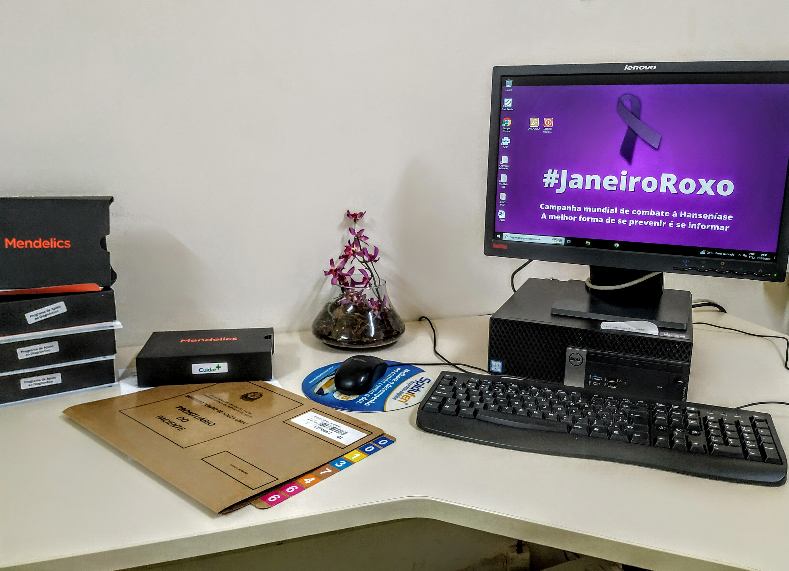
Rare Diseases (Doenças Raras) Program
79 without diagnosis in the biopsy
Increasing the diagnosis of PN in this Center and reducing the need of nerve biopsy

Slide 14
TEACHING in Rehabilitation Branch and Clinical Neurophysiology
Rehabilitation Branch
Duerksen F, Opromolla DVA, Virmond M, Garbino JA. Teaching and training for surgical rehabilitation in hanseniasis: results of 20 years activities of the Instituto Lauro de Souza Lima in South América. Hansenologia Internationalis (Impresso), v. 24, 1999.
Postgraduate “lato sensu” Programme in Clinical Neurophysiology (2001 - ...)
Short term courses, residents: 25 students
In this period until 2009, 4 national courses hands-on were promoted, with good acceptance
Then Specialization were start: 17 specialists were trained and 3 students are being trained. Comming from brazilian regions: Midwest, South, Southeast and North east and Countries: Italy, Africa and Nedherlands

Slide 15
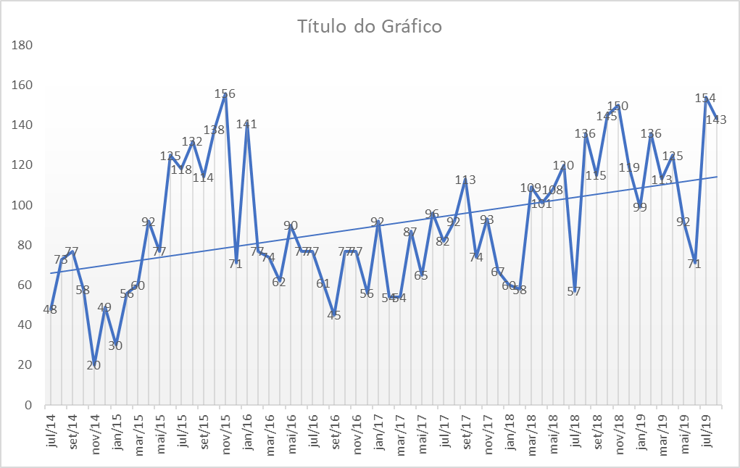
ENMG NUMBER EVOLUTION IN 5 YEARS BEFORE THE PANDEMIC

Slide 16
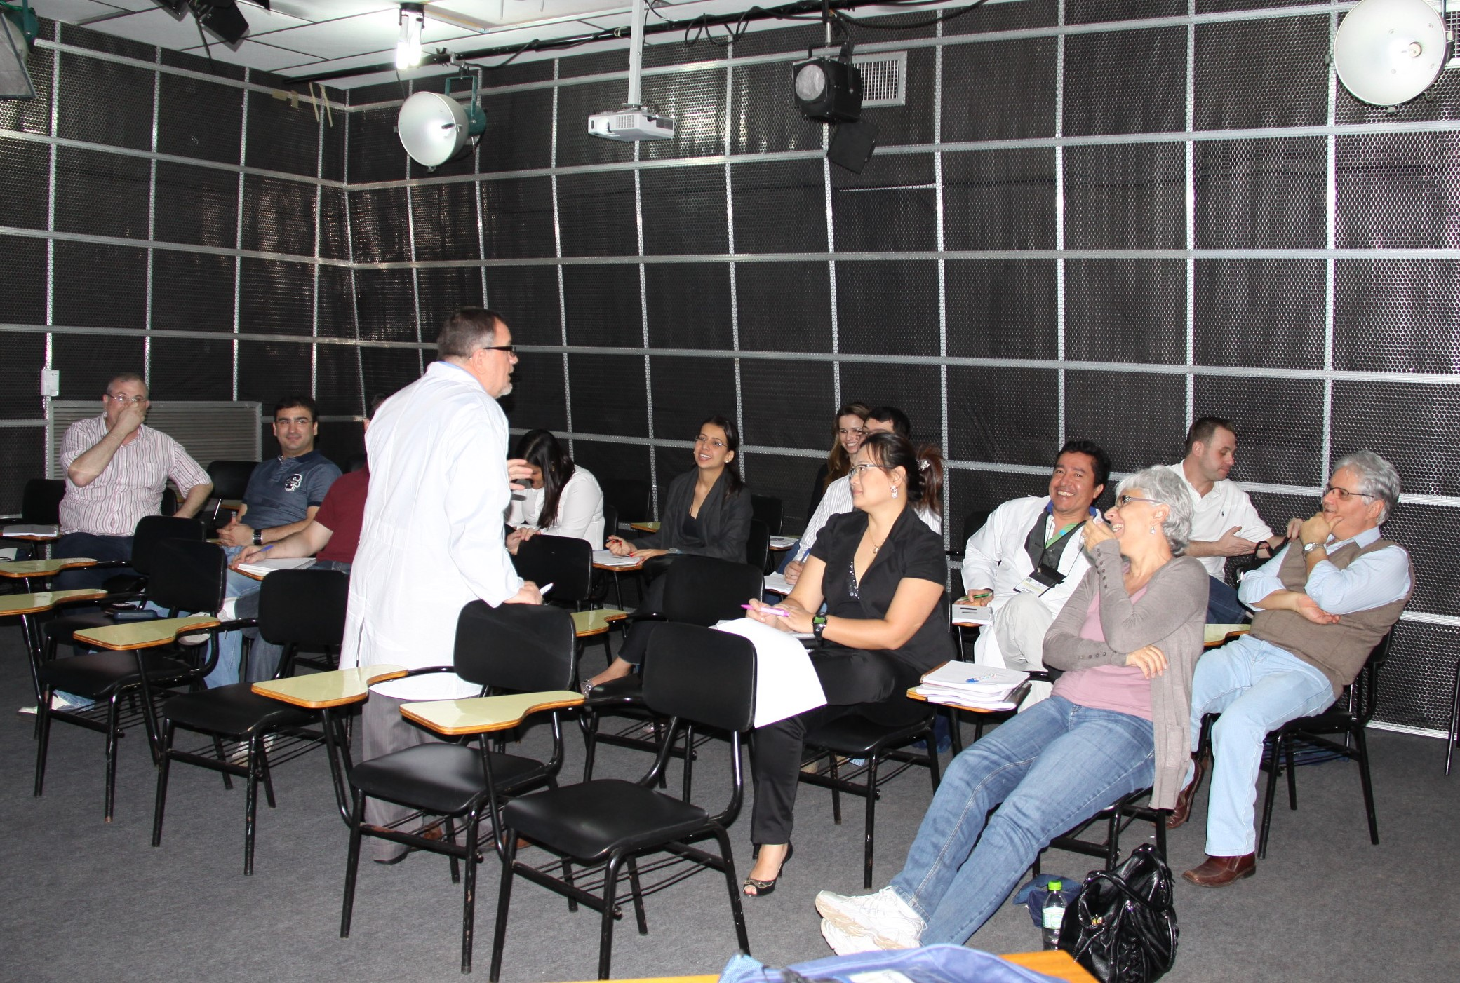
Thanks
Thanks

